Slide 1


REAL TIME OBJECT
SIZE MEASURMENT

Slide 2


INTRODUCTION
In today’s world, technology plays a crucial role in simplifying complex tasks.
One such task is real-time object measurement, which has applications in various fields like robotics, quality control in manufacturing, augmented reality, and more.
This project utilizes computer vision techniques to measure an object’s dimensions directly from a webcam feed.
By processing images captured by the webcam, the system provides real-time size measurements of objects in centimeters, offering a cost-effective alternative to using traditional measurement tools.

Slide 3
ABSTRACT
This project aims to develop a real-time object measurement system that uses a webcam to capture images of an object and calculates its dimensions using computer vision algorithms.
By applying techniques like contour detection, image thresholding, and object calibration, the system processes the live video feed to identify and measure the size of objects within the camera’s view.
The proposed solution leverages the OpenCV library for image processing and Tkinter for the graphical user interface, providing an interactive and efficient tool for real-time object measurement.

Slide 4

PROBLEM STATEMENT
Traditional measuring tools, such as rulers or calipers, are manual and time-consuming, especially when dealing with numerous objects or when precision is critical.
Additionally, in applications like manufacturing and robotics, automated measurement is necessary to increase efficiency and reduce human error.
Current solutions for object measurement either require expensive hardware or are not capable of real-time processing, which limits their effectiveness in dynamic environments.

Slide 5
Existing Solutions
Manual Measurement:
Using rulers, calipers, or measuring tapes is accurate but slow and prone to human error.
Laser Measurement Tools:
These devices provide high accuracy but are expensive and limited to specific types of measurements.
3D Scanning and Stereoscopic Vision:
These solutions use complex hardware setups, which are costly and require specialized expertise.

Slide 6
Proposed Solution
The system uses a webcam to capture live images of the object.
Then applies contour detection and edge detection algorithms
That identify the object’s boundaries, and calculates its size based on the camera’s pixel-to-centimeter ratio .
Key features:
Real-time processing using OpenCV.
Interactive interface built with Tkinter.
Calibration mechanism to adjust for different objects and camera setups.
Accurate measurements by filtering out irrelevant contours.

Slide 7
Workflow with Algorithms
Capture Frame: The webcam continuously captures video frames.
Preprocessing: Each frame is converted to grayscale and blurred to remove noise.
Edge Detection: Canny edge detection is applied to find the edges of objects in the frame.
Contour Detection: The contours of the objects are found using cv2.findContours().
Object Filtering: Filters are applied to select the relevant object (based on size and shape).
Object Measurement: The width and height of the object are calculated based on its bounding box and the pixel-to-centimeter ratio.
Display Measurement: The measurements are displayed on the interface, and the object is outlined with a rectangle.
Notes:
[Begin with a warm tone to engage the audience]
As we dive into the methods of our project, let's first acknowledge the significance of accurate object measurement in various design fields, such as fashion, furniture, and prototyping.
[Pause for effect]
Traditional methods, like using rulers and tapes, can be quite time-consuming and often lead to errors, especially when dealing with irregular or complex shapes.
This is where our innovative solution comes into play. We are proposing a real-time measurement system that leverages the power of OpenCV.
[Emphasize the innovation]
Using image processing techniques like edge detection and contour analysis with a live camera feed, we ensure precision in measurement. A reference object of known size is incorporated into the frame, allowing for accurate calibration.
The best part? The system displays the real-world dimensions in centimeters or inches right on the screen!
[Conclude with the benefits]
Our goal is simple: to enhance efficiency and accuracy while significantly reducing manual errors in the design process.
[Pause to let that resonate with the audience]
Let’s move on to explore how this system functions in greater detail.

Slide 8
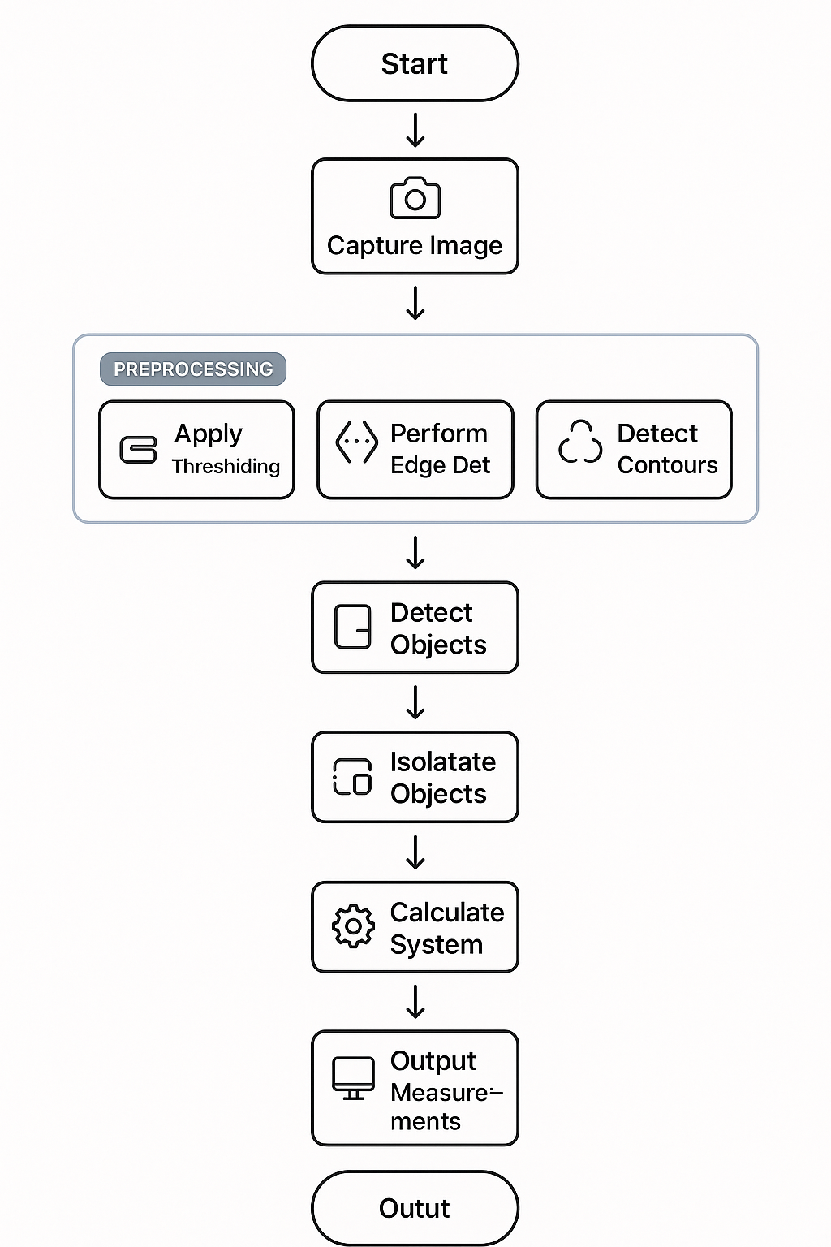

FLOWCHART

Slide 9
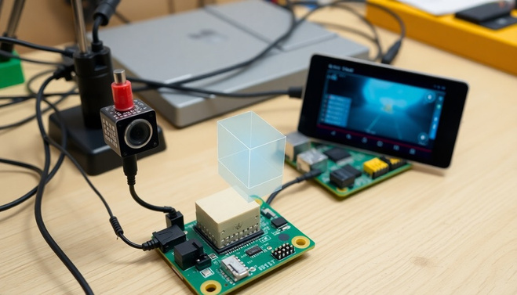
IMPLEMENTATION & SETUP
Hardware Requirements:
Webcam: A standard webcam capable of capturing HD video (1280x720).
Computer: A system with Python installed and sufficient processing power to run real-time image processing algorithms.

Slide 10
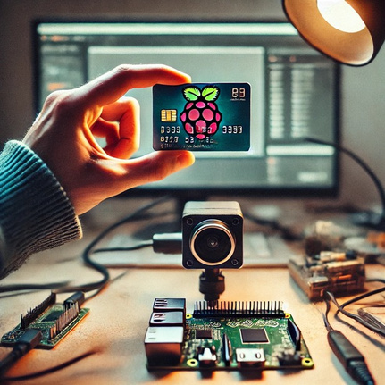
IMPLEMENTATION & SETUP
Software Requirements:
Python (3.x or higher) & OpenCV library (opencv-python).
Tkinter for GUI development.
Pillow for handling image processing in Tkinter.

Slide 11
IMPLEMENTATION & SETUP
Setup Steps:
Install Python and necessary libraries using pip install opencv-python tkinter pillow.
Connect the webcam and ensure it’s recognized by the system.
Run the Python script to launch the real-time measurement application.

Slide 12
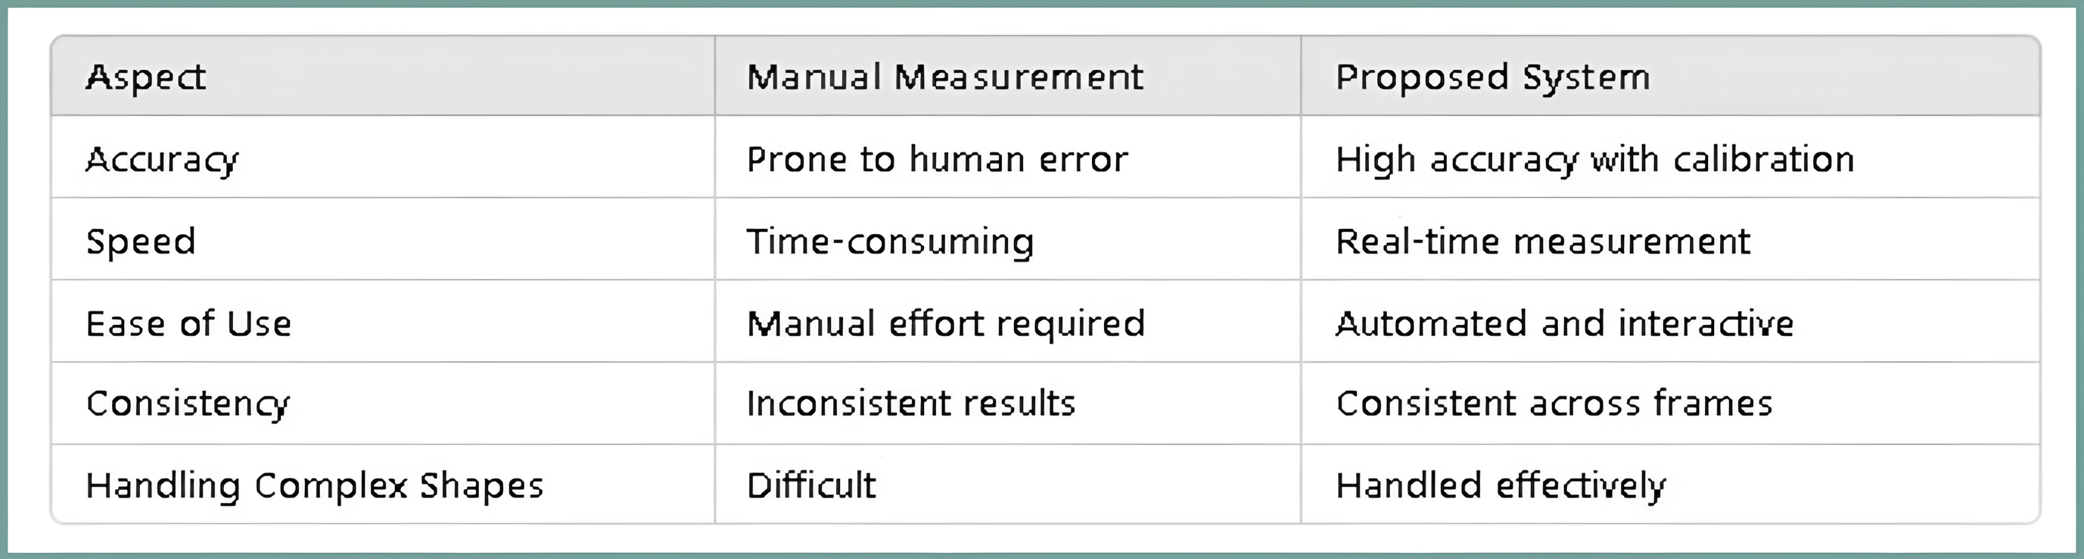
Expected Outcome
The expected outcome of this project is a fully functional real-time object measurement tool that:
Accurately measures the width and height of an object in centimeters.
Provides live feedback, with the object clearly outlined and its dimensions displayed.

Slide 13
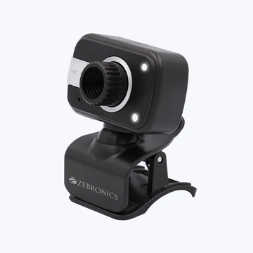
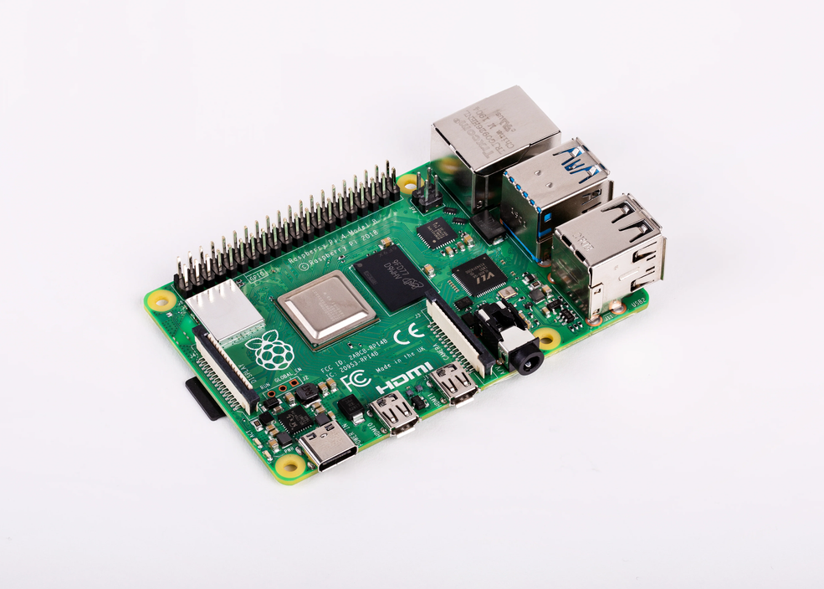
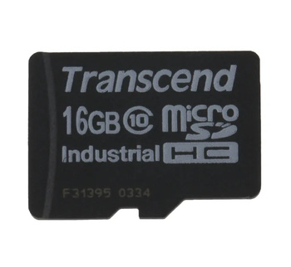
COMPONENTS
Raspberry Pi: The central processing unit for running the object measurement system.
Webcam: For capturing live video of the object.
Python & OpenCV: For real-time video processing and object detection.
Tkinter: For displaying the real-time webcam feed and the object’s measured dimensions on the screen.
Calibration Object: A known object, like a ruler or a reference item of known size, used to calibrate the camera’s pixels-per-centimeter ratio to ensure accurate measurements.

Slide 14
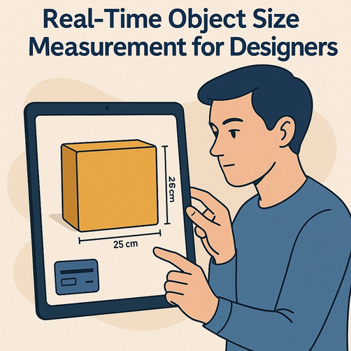
Conclusion
This project successfully implements a real-time object measurement system using computer vision techniques.
By integrating OpenCV for image processing and Tkinter for a user-friendly interface, the system provides an solution for measuring objects in real-time.
The project demonstrates the potential of open-source tools for solving practical measurement challenges.

Slide 15
Thank You !

